Slide 1
CHAIRMAN’S
REPORT
01 March 2024 – 28 February 2025

Slide 2
AGENDA
2
3
Activities throughout the Year
Weekly activities
Q&A

Slide 3
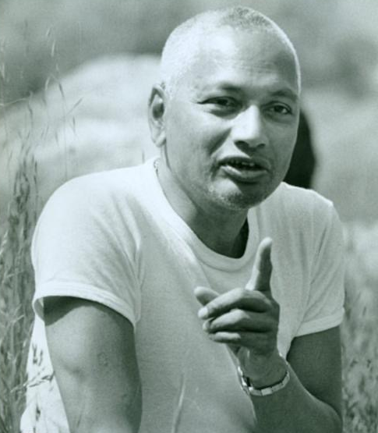
ACTIVITIES
Mar 2024
Apr 2024
May 2024
Jun 2024
Jul 2024
Aug 2024
Sep 2024
Oct 2024
Nov 2024
Dec 2024
Jan 2025
Feb 2025
Sri Swami Venkatesananda

Slide 4
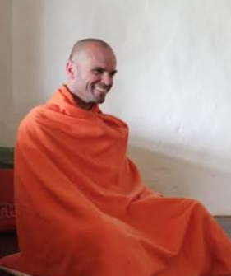

March 2024
21 Mar – 02 Apr:
Swami Vidyananda and Santosh: Proof Reading Seva in Barrydale and evening lecture series

Slide 5
April 2024
11 Apr:
Yoga fee increase
28 Apr:
108 Hanuman Chalisa Recitals @ Vishnu Mandir Gatesville
30 Apr:
Special Satsang for Swamis from the Sannyas Spiritual Council

Slide 6
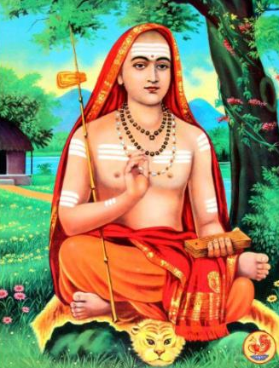
May 2024
11 May:
Special Film Screening and Satsang: Sri Adi Shankaracharya
Sri Adi Shankaracharya was one of the most important Spiritual Masters of India who lived in the 9th century.
His writings are still a guiding light to millions of seekers.
His teachings have become part of many yogic and vedantic traditions due to the profundity and deep insights into reality that he had.
Sri Adi Shankaracharya
25 May:
Annual Gathering of Members

Slide 7
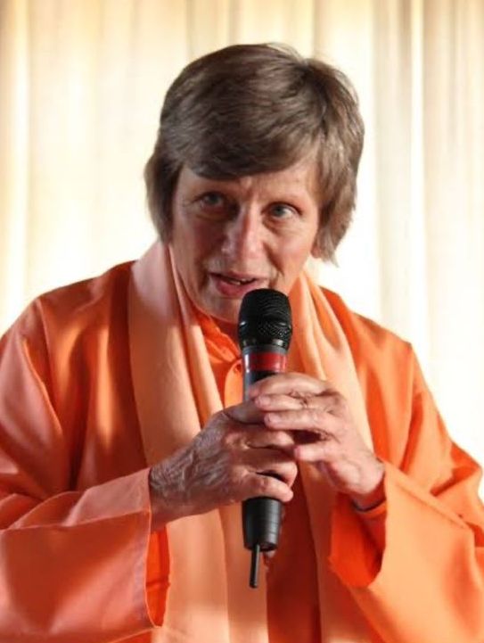
June 2024
1 Jun:
Swami Sivananda’s Sannyas Diksha Centenary
12 Jun:
Swami Parvathiananda’s birthday satsang
Swami Parvathiananda

Slide 8
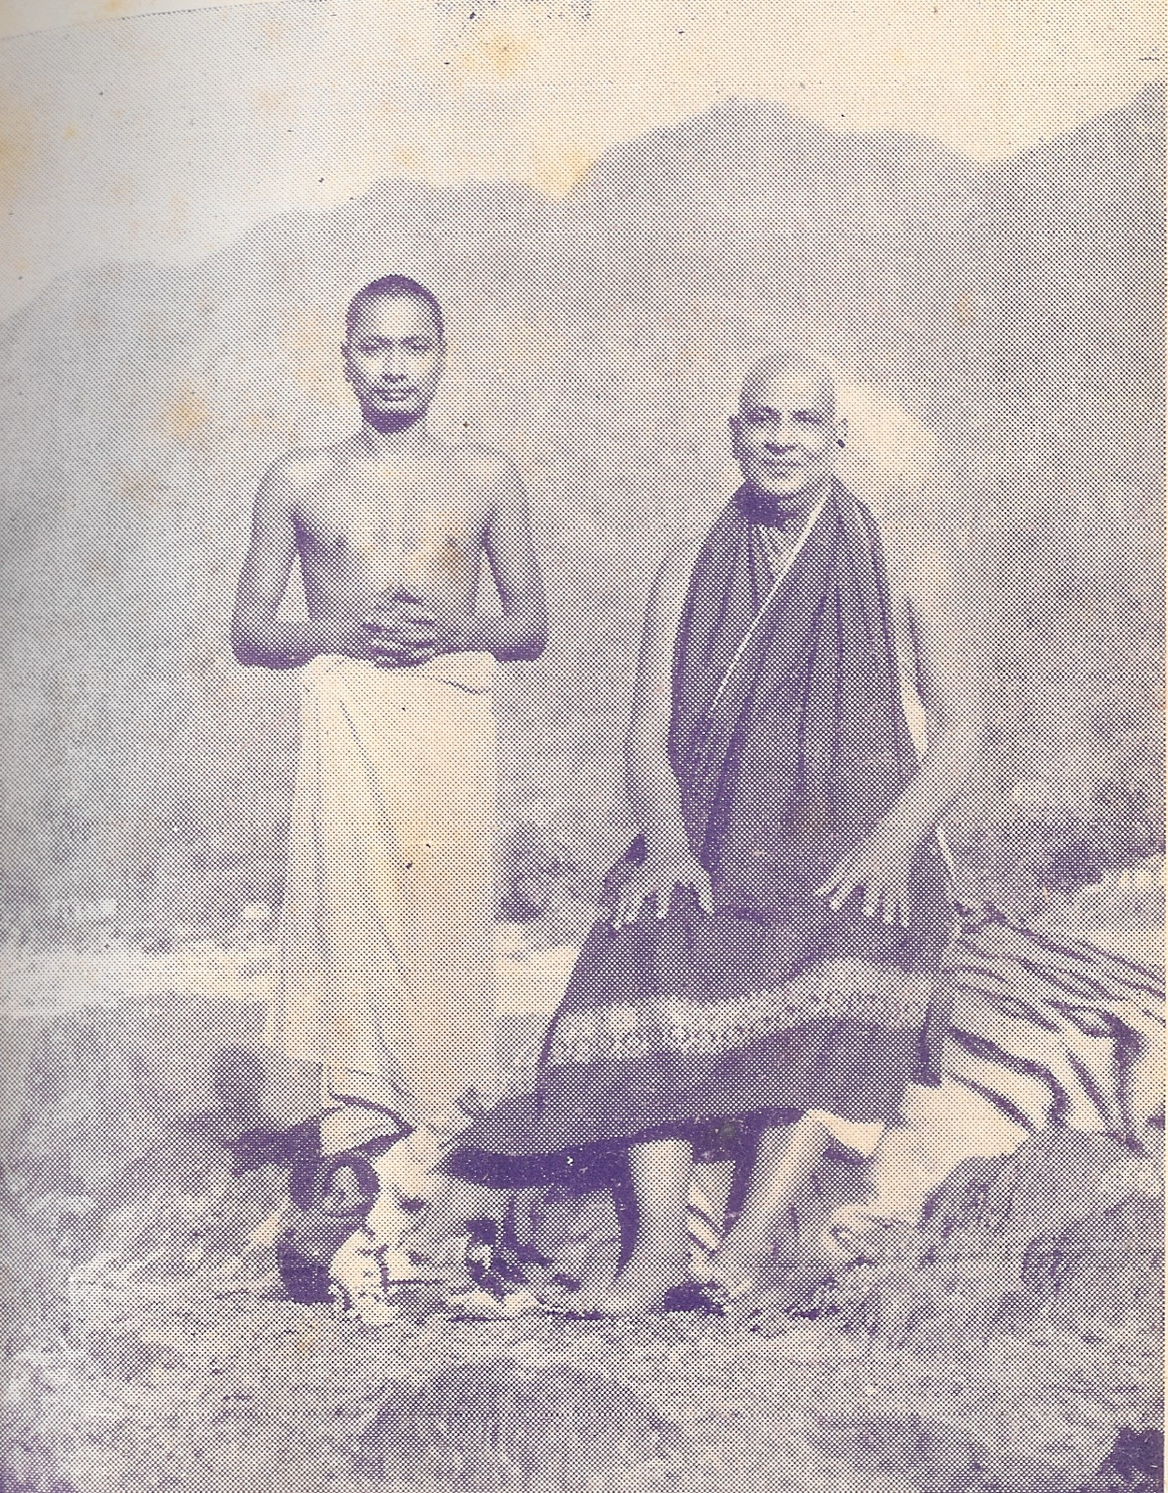
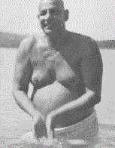
July 2024
06 – 11 Jul:
Proofreading Seva in Barrydale, Swami Vidyananda and Santosh
Sri Guru Purnima
21 Jul:
Sri Guru Purnima
22 - 28 Jul:
Sadhana week, a series of special talks by Swami Vidyananda
28 Jul:
Sri Gurudev's Mahasamadhi Satsang
Swami Sivananda Mahasamadhi

Slide 9
August 2024
06 Aug:
Mother Yogeshwari’s Birth Anniversary with special guest speaker, Judy Tobler (a sister disciple of Mother Yogeshwari)
17 Aug:
Proofreading Day at the Ashram
18 Aug :
Swami Vidyananda gave a talk at the Unitarian Church on the Yoga of the Bhagavad Gita.
26 Aug:
Sri Krishna Jayanti
30 Aug:
Desert Rose, Echoes of the Divine. A Sacred World Music Journey
31 Aug:
The Mahasamadhi Anniversary of Sri Swami Chidananda Ji Maharaj

Slide 10
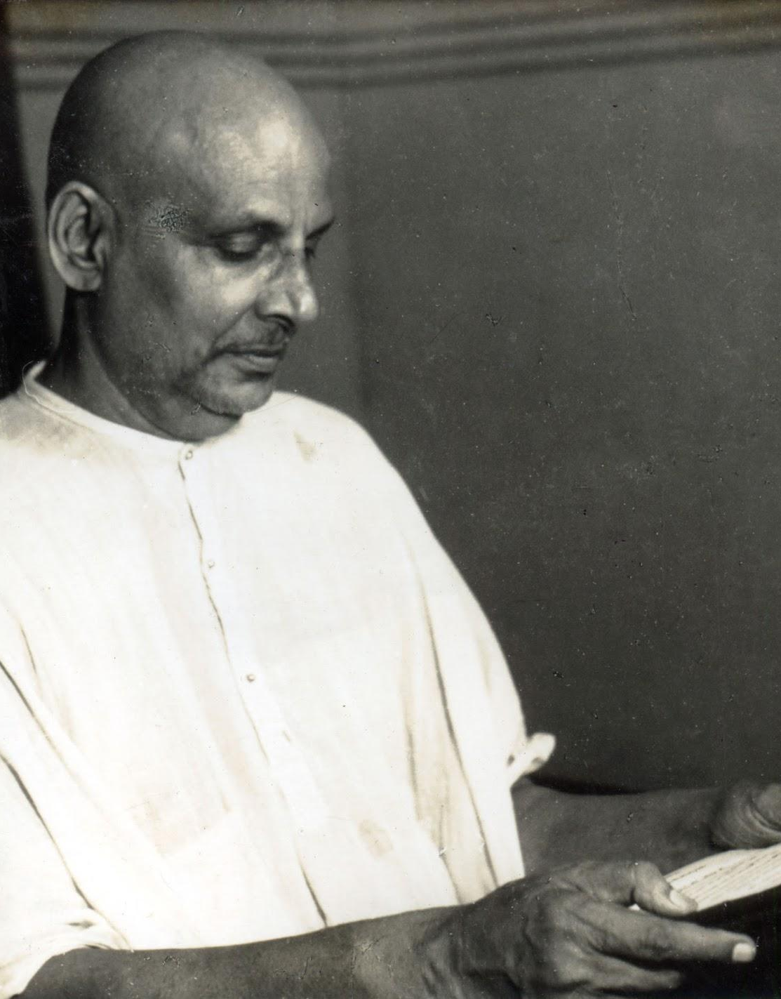
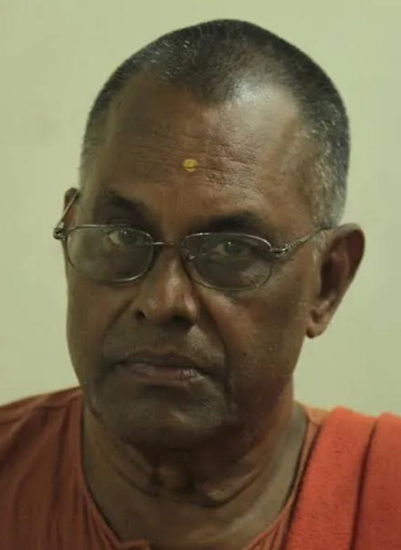
September 2024
08 Sep:
Swami Sivananda Birth Anniversary Satsang
17– 21 Sep:
Special Lecture Satsangs with Swami Muktananda in Residence @ Ananda Kutir Ashrama
Swami Sivananda
Swami Muktananda

Slide 11
October 2024
03 – 12 Oct:
A celebration of Navaratri
19 Oct:
Uncle Steve and Parashakti Mataji with family went on pilgrimage to India. This is always a time of inspiration, when visiting holy places. Parashakti Mataji shared with us their wonderful experiences of various ashrams and other holy places that they visited.
26 Oct - 03 Nov:
Swami Vidyananda proofreading week in Barrydale with Uma Mataji and Bhaktipriya Mataji, including lecture series on Karma Yoga.

Slide 12
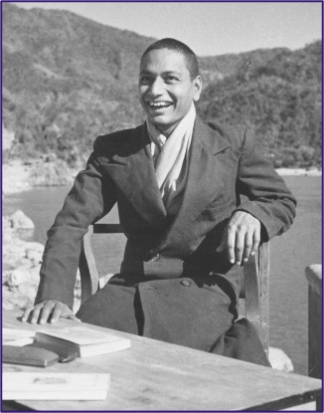
November 2024
09 Nov:
Mother Yogeshwari’s Mahasamadhi Satsang was celebrated with talks by Swami Parvathiananda, Swami Vidyananda and Dayananda Naidu. The Global Akhanda Kirtan was held that same evening and devotees of the Ashrama offered kirtans at their function.
16 Nov:
Thank you, Tea, and Satsang for Proofreaders
Observance of the anniversary of Sri Swami Venkatesananda Ji’s Mahasamadhi with a special function at which He was remembered through various spiritual activities.
Sri Swami Venkatesananda
17 Nov:

Slide 13
November 2024 Continued
23 Nov:
Maitri Makan Mataji offered a presentation of her pilgrimage to India where she visited a number of ashrams and holy shrines.
Note:
Swami Parvathiananda, who was in Australia gave a talk at the Sivanandashram, Perth, in which she spoke about her book on Ananda Kutir Ashrama

Slide 14
December 2024
02 Dec:
Interfaith Satsang – The Religion of Love. Presentations were made by devotees as well as Geoff Barkley
03 Dec:
Maha Mantra Akhanda Kirtan
Dec/Jan:
The Ashram and Residences are painted
16 Dec:
Paint prepping Seva
24 Dec:
Christmas Eve Satsang

Slide 15
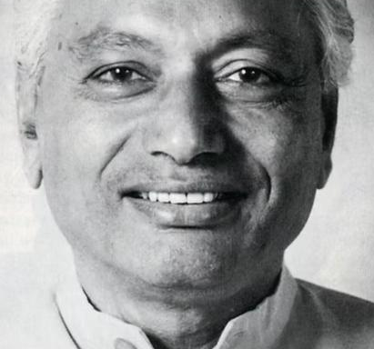
December 2024
02 Dec:
Special Programme commemorating the Birth Anniversary of Sri Swami Venkatesananda. This was followed by distributing food collected, to the poor.
Dec/Jan:
Swami Vidyananda’s Lecture as part of the Divine Life Society Rishikesh Christmas – New Year Retreat 2024. Theme: Lead Us from the Unreal to the Real. The Meaning and Implications. This talk was included in the Ashram’s Mahasamadhi Programme
Sri Swami Venkatesananda

Slide 16
January 2025
02 Jan:
Cleaning seva post painting the main building
12 Jan:
The painting project was completed
13 Jan:
Hatha classes resumed
14 Jan:
Yoga Sutras of Patanjali resumed
15 Jan:
The Supreme Yoga Satsang resumed
20 Jan:
Vedanta via zoom resumed
26 Jan:
Swami Parvathi returns to Ananda Kutir Ashrama from Australia

Slide 17
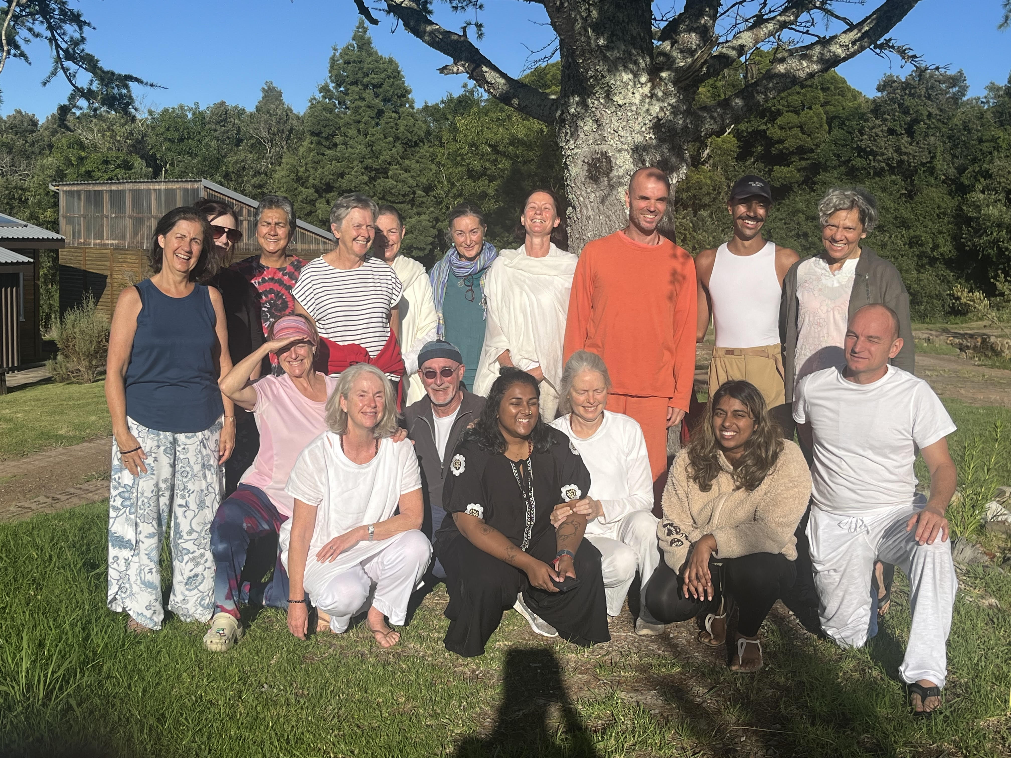
February 2025
02 – 07 Feb :
Integral Yoga Retreat with Swami Vidyananda and Friends @ Grootvadersbosch

Slide 18
February 2025 Continued
15 Feb:
Vani Mataji’s Birthday Satsang
16 Feb:
Higher Steenberg hike with Evelyn Holtzhausen
25 Feb:
Special talk on yoga, meditation and the use of technology by Swami Vidyananda
26 Feb:
Celebrating Shivaratri

Slide 19
Regular Weekly Activities
In addition to the aforementioned, the following regular activities have continued to take place:
Saturday:
Satsangs
Monday:
Vedanta with Swami Vidyananda via Zoom
Tuesday:
Yoga Sutras of Patanjali / Meditation classes with Swami Vidyananda
Wednesday:
The Yoga Vasishtha via Zoom with Swami Parvathiananda
The Supreme Yoga Satsang with Swami Vidyananda
Mon to Sat:
Hatha classes

Slide 20
Thank You
Q&A Session

